Slide 1
COURSE NAME : Data Structure
COURSE CODE : CSE207
SECTION: 02
SUBMITTED TO : Dr. Maheen Islam
Associate Professor
Department of CSE
EAST WEST UNIVERSITY
SUBMITTED BY: Sheikh Shemanto Afridi. [2019-1-60-241]
Dewan Sultan Al-Amin. [2019-2-62-035]
Problem No : 1.
Project Name : Implementation of Dynamic Table.

Slide 2
Introduction
We have developed a code that generates dynamic table. This dynamic table is a student info table, which take students id, name, age, cgpa as input. It can store data as much as we desire. The table has a menu which has options like,
1 : Insert Data.
2 : Print table.
3 : Sum of Students .
4 : Average CGPA of Student.
5 : Search Student By ID.
6 : Print Maximum CGPA Student's Data.
7 : Print Minimum CGPA Student's Data.
8 : Sort Table By CGPA.
9 : Sort Table by Age.
10: Remove Student.
11 : Exit.
Link list, pointer, array, dynamic allocation, function has been used to developed the code.
INTRODUCTION
INTRODUCTION

Slide 3
CODE
#include<stdio.h>
#include<stdlib.h>
#include<string.h>
struct info
{
int id;
char name[20];
int age;
double cgpa;
};
struct info *table=NULL;
int len=0,mem=1;
void insert()
{
len++;
if(len==mem)
{
mem=len*2;
if ( (table=(struct info*)realloc(table,mem*sizeof(struct info)))==0)
{
printf("ERROR!");
}
}
);
}

Slide 4
CODE
printf("Enter Student's ID: ");
scanf("%d",&(table+(len-1))->id);
printf("Enter Student's Name: ");
scanf("%s",(table+(len-1))->name);
printf("Enter Student's Age: ");
scanf("%d",&(table+(len-1))->age);
printf("Enter Student's CGPA: ");
scanf("%lf",&(table+(len-1))->cgpa
void print(int i)
{
printf(" %d",(table+i)->id);
for(int j=0; j<5; j++){ printf(" ");}
printf("%s",(table+i)->name);
for(int k=0; k<(25-strlen((table+i)->name)); k++) {printf(" ");}
printf("%d",(table+i)->age);
for(int l=0; l<11; l++) {printf(" ");}
printf("%lf\n",(table+i)->cgpa);
} void printTable()
{
printf(" ID Name Age CGPA\n");
printf(" ---- ------ ----- --------\n\n");
for(int i=0; i<len; i++)
{
print(i);
}
}

Slide 5
CODE
int sum()
{
int i;
double sum=0;
for(i=0; i<len; i++)
{
sum+= (table+i)->cgpa;
}
return sum;
}
int search(int id)
{
for(int i=0; i<len; i++)
{
if((table+i)->id==id)
{
return(i);
}
}
return(-1);
}

Slide 6
CODE
void findMaxCgpa()
{
double max=(table+0)->cgpa;
int flag;
for(int i=0; i<len; i++)
{
if((table+i)->cgpa>max) {flag=i;}
}
printf("\n\nHighest CGPA Student's Name = %s || Age = %d || CGPA = %lf\n\n",(table+flag)- >name,(table+flag)->age,(table+flag)->cgpa);
}
void findMinCgpa()
{
double min=(table+0)->cgpa;
int flag;
for(int i=0; i<len; i++)
{
if((table+i)->cgpa<min) {flag=i;}
}
printf("\n\nLowest CGPA Student's Name = %s || Age = %d || CGPA = %lf\n\n",(table+flag)->name,(table+flag)->age,(table+flag)->cgpa);
}

Slide 7
CODE
void sortTabCgpa()
{
double *CTable[len],*temp;
for(int i=0; i<len; i++)
{
CTable[i]=&(table+i)->cgpa;
}
for(int i=0; i<len; i++)
{
for(int j=i+1; j<len; j++)
{
if(*CTable[j]<*CTable[i])
{
temp=CTable[i];
CTable[i]=CTable[j];
CTable[j]=temp;
}
}
}
printf("\n Student Sorted Table By CGPA");
printf("\n-----------------------------------------------------------------\n");
printf(" ID Name Age CGPA\n");
printf(" ---- ------ ----- --------\n\n");

Slide 8
CODE
for(int i=0; i<len; i++)
{
for(int j=0; j<len; j++)
{
if(*CTable[i]==(table+j)->cgpa) {print(j);}
}
}
}
void sortTabAge()
{
int *CTable[len],*temp;
for(int i=0; i<len; i++)
{
CTable[i]=&(table+i)->age;
}
for(int i=0; i<len; i++)
{
for(int j=i+1; j<len; j++)
{
if(*CTable[j]<*CTable[i])
{
temp=CTable[i];
CTable[i]=CTable[j];
CTable[j]=temp;
}
}
}

Slide 9
CODE
printf("\n Student Sorted Table By CGPA");
printf("\n-----------------------------------------------------------------\n");
printf(" ID Name Age CGPA\n");
printf(" ---- ------ ----- --------\n\n");
for(int i=0; i<len; i++)
{
for(int j=0; j<len; j++)
{
if(*CTable[i]==(table+j)->age) {print(j);}
}
}
}
int removeStd(int pos)
{
for(int i=pos,j=pos+1; i<len; i++,j++)
{
(table+i)->id=(table+j)->id;
strcpy((table+i)->name,(table+j)->name);
(table+i)->age=(table+j)->age;
(table+i)->cgpa=(table+j)->cgpa;
}
len--;
if(len<mem/2)
{table=(struct info*)realloc(table,mem/2*sizeof(struct info));}
return 1;
}

Slide 10
CODE
int main()
{
int choice;
while(1){
printf("\n----------------------------\n");
printf(" Table Menu\n");
printf("----------------------------\n");
printf(" 1 : Insert Data\n");
printf(" 2 : Print table\n");
printf(" 3 : Sum of Students CGPA\n");
printf(" 4 : Average CGPA of Student\n");
printf(" 5 : Search Student By ID\n");
printf(" 6 : Print Maximum CGPA Student's Data\n");
printf(" 7 : Print Minimum CGPA Student's Data\n");
printf(" 8 : Sort Table By CGPA\n");
printf(" 9 : Sort Table by Age\n");
printf(" 10: Remove Student\n");
printf(" 11 : Exit\n");
printf("\n--------------------------------------\n");
printf("Now Tell Me What Do You Desire:");
scanf("%d",&choice);

Slide 11
CODE
switch(choice)
{
case 1:
insert();
break;
case 2:
if(table!=NULL)
{
printf("\n Student Table\n");
printf("-----------------------------------------------------------------\n\n");
printTable();
}
else {printf("\nThere are No Data in the Table. Please Insert Data First.\n");}
break;
case 3:
if(table!=NULL)
{
int total=sum();
printf("The Sum of the CGPA is %d\n",total);
}
else {printf("\nThere are No Data in the Table. Please Insert Data First.\n");}
break;

Slide 12
CODE
case 4:
if(table!=NULL)
{
double avg;
double total=sum();
avg=(total)/len;
printf("len=%d\n",len);
printf("\n\nAverage of Students CGPA is = %lf\n\n",avg);
}
else {printf("\nThere are No Data in the Table. Please Insert Data First.\n");}
break;
case 5:
if(table!=NULL)
{
int id;
printf("Enter Student Id: ");
scanf("%d",&id);
int found=search(id);
if(found==-1)
{
printf(" Did not find the Student\n");
}
else
{
printf("\n\nID Found.\nName=%s || Age=%d || CGPA=%lf\n\n",(table+found)->name,(table+found)->age,(table+found)->cgpa);
}
}

Slide 13
CODE
else {printf("\nThere are No Data in the Table. Please Insert Data First.\n");}
break;
case 6:
if(table!=NULL){ findMaxCgpa();}
else {printf("\nThere are No Data in the Table. Please Insert Data First.\n");}
break;
case 7:
if(table!=NULL){ findMinCgpa();}
else {printf("\nThere are No Data in the Table. Please Insert Data First.\n");}
break;
case 8:
if(table!=NULL){ sortTabCgpa();}
else {printf("\nThere are No Data in the Table. Please Insert Data First.\n");}
break;
case 9:
if(table!=NULL){ sortTabAge();}
else {printf("\nThere are No Data in the Table. Please Insert Data First.\n");}
break;

Slide 14
CODE
case 10:
if(table!=NULL)
{
int id;
printf("\n\nEnter the Id of the Student: ");
scanf("%d",&id);
int found=search(id);
if(found==-1)
{
printf(" Did not find the Student\n");
}
else
{
int deleted=removeStd(found);
if(deleted==1)
{
printf("\n\nStudent Removed Successfully!\n\n");
}
else
{
printf("\n\nSomething is Wrong!\n\n");
}
}
}
else {printf("\nThere are No Data in the Table. Please Insert Data First.\n");}
break;

Slide 15
CODE
case 11:
exit(0);
break;
default:
printf("\nYou Have A Wrong Desire\n");
break;
}
}
return 0;
}

Slide 16
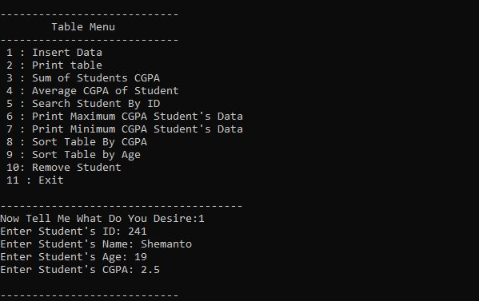
Output Screenshot

Slide 17
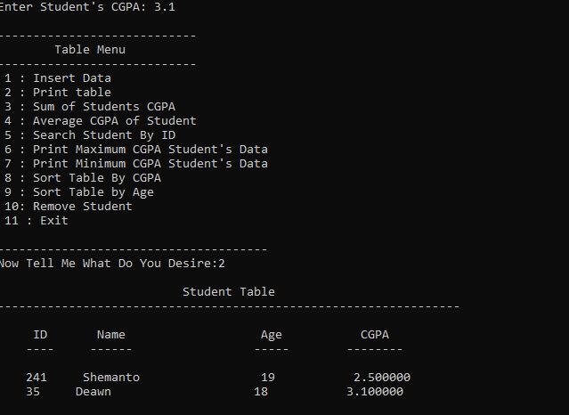
Output Screenshot

Slide 18
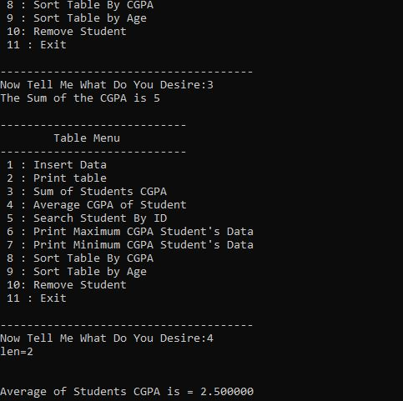
Output Screenshot

Slide 19
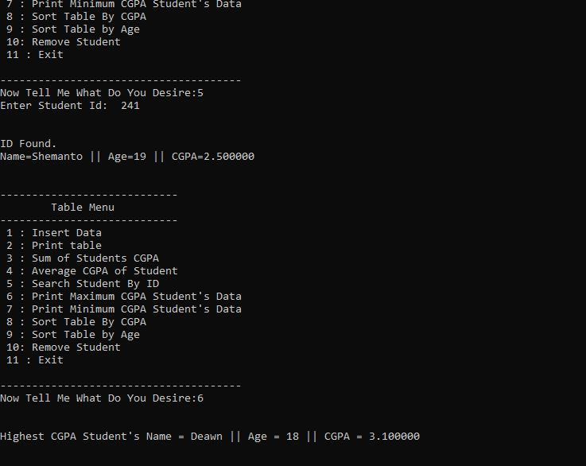
Output Screenshot

